Slide 1
Lambda Expression, LINQ API

Slide 2

Lesson Objectives
Understand Lambda Expression
LINQ API

Slide 3
Lambda Expressions
Section 1

Slide 4
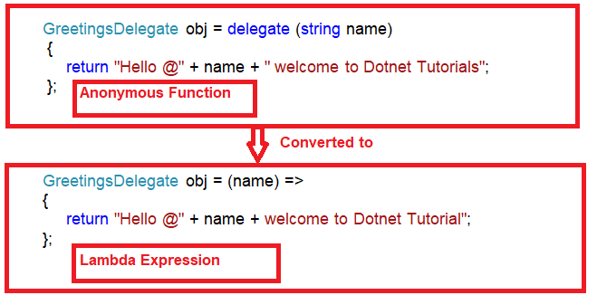
Introduction
Use a lambda expression to create an anonymous function.
Use the lambda declaration operator => to separate the lambda's parameter list from its body.
A lambda expression is an expression of any of the following two forms:
Expression lambda that has an expression as its body:
Statement lambda that has a statement block as its body:
(input-parameters) => expression
(input-parameters) => { <sequence-of-statements> }

Slide 5
Expression Lambdas 1-3
An expression lambda is a lambda with an expression on the right side.
The input parameters may be implicitly typed or explicitly typed.
When there are two or more input parameters on the left side of the lambda operator, they must be enclosed within parentheses. However, if you have only one input parameter and its type is implicitly known, then the parentheses can be omitted. For example,
(str, str1) => str == str1
It means str and str1 go into the comparison expression which compares str with str1. In simple terms, it means that the parameters str and str1 will be passed to the expression str == str1.
Here, it is not clear what are the types of str and str1.
Hence, it is best to explicitly mention their data types:
(string str, string str1)=> str==str1
Syntax
(input_parameters) => expression
where,
input_parameters: one or more input parameters, each separated by a comma
expression: the expression to be evaluated

Slide 6
Expression Lambdas 2-3
To use a lambda expression:
Declare a delegate type which is compatible with the lambda expression.
Then, create an instance of the delegate and assign the lambda expression to it. After this, you will invoke the delegate instance with parameters, if any.
This will result in the lambda expression being executed. The value of the expression will be the result returned by the lambda.
The following code demonstrates expression lambdas:
Snippet
/// <summary>
/// Class ConvertString converts a given string to uppercase
/// </summary>
public class ConvertString{
delegate string MakeUpper(string s);
public static void Main() {
// Assign a lambda expression to the delegate instance
MakeUpper con = word => word.ToUpper();
// Invoke the delegate in Console.WriteLine with a string
// parameter
Console.WriteLine(con("abc"));
}
}

Slide 7

Expression Lambdas 3-3
In the code:
A delegate named MakeUpper is created and instantiated. At the time of instantiation, a lambda expression, word => word.ToUpper()is assigned to the delegate instance.
The meaning of this lambda expression is that, given an input, word, call the ToUpper() method on it.
ToUpper() is a built-in method of String class and converts a given string into uppercase.
The following figure displays the output of using expression lambdas:
Output

Slide 8
Statement Lambdas
A statement lambda is a lambda with one or more statements. It can include loops, if statements, and so forth.
where,
input_parameters: one or more input parameters, each separated by a comma
statement: a statement body containing one or more statements
Optionally, you can specify a return statement to get the result of a lambda.
(string str, string str1)=> { return (str==str1);}
The following code demonstrates a statement lambda expression:
Syntax
(input_parameters) => {statement;}
/// <summary>
/// Class WordLength determines the length of a given word or phrase
/// </summary>
public class WordLength{
// Declare a delegate that has no return value but accepts a string
delegate void GetLength(string s);
public static void Main() {
// Here, the body of the lambda comprises two entire statements
GetLength len = name => { int n =
name.Length;Console.WriteLine(n.ToString()); };
// Invoke the delegate with a string
len("Mississippi");
}
}
Snippet

Slide 9
Lambdas with Standard Query Operators 1-2
Lambda expressions can also be used with standard query operators.
The following table lists the standard query operators:
The following shows how to use the OrderBy operator with the lambda operator to sort a list of names:
Operator | Description
Sum | Calculates sum of the elements in the expression
Count | Counts the number of elements in the expression
OrderBy | Sorts the elements in the expression
Contains | Determines if a given value is present in the expression
Snippet
/// <summary>
/// Class NameSort sorts a list of names
/// </summary>
public class NameSort{
public static void Main() {
// Declare and initialize an array of strings
string [ ] names = {"Hanna", "Jim", "Peter", "Karl", "Abby",
"Benjamin"};
foreach (string n in names.OrderBy(name => name)) {
Console.WriteLine(n);
}
}
}

Slide 10
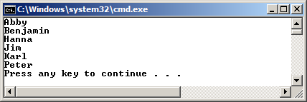
Lambdas with Standard Query Operators 2-2
The following figure displays the output of the OrderBy operator example:

Slide 11
Lambda Expression - Summary
Use the lambda declaration operator => to separate the lambda's parameter list from its body. To create a lambda expression, you specify input parameters (if any) on the left side of the lambda operator and an expression or a statement block on the other side.

Slide 12
Language Integrated Query (LINQ)
Section 2

Slide 13
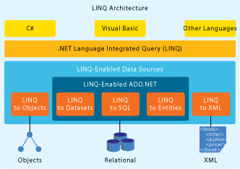
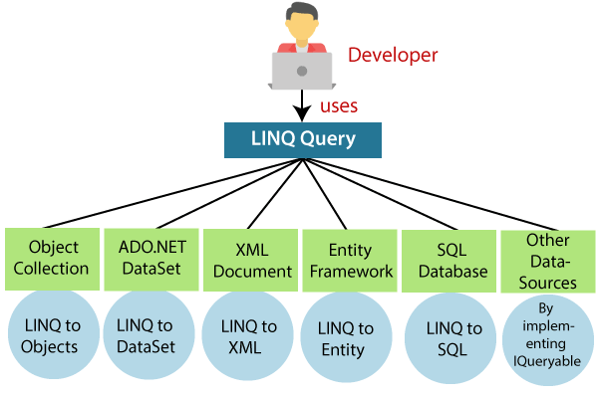
What's LINQ?
What's LINQ?
Language Integrated Query
LINQ is a query syntax built in C # and VB.NET used to save and retrieve data from different types of data sources like an Object Collection, SQL server database, XML, web service etc.

Slide 14
Advantages
Syntax highlighting
Easy debugging
Extensible that means it is possible to query new data sourcetypes.
Facility of joining several data sources in a single query.
Easy transformation (like transforming SQL data to XML data . )

Slide 15
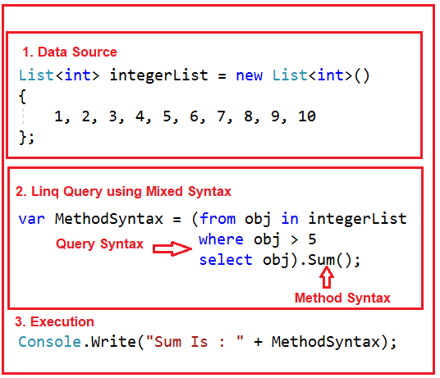
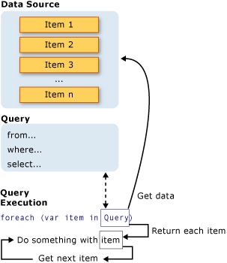
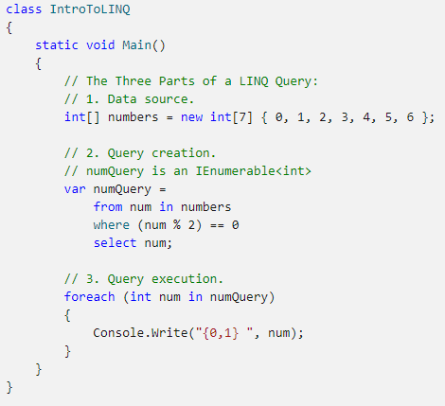
Three Parts of a Query Operation
All LINQ query operations consist of three distinct actions:
Obtain the data source.
Create the query.
Execute the query.

Slide 16
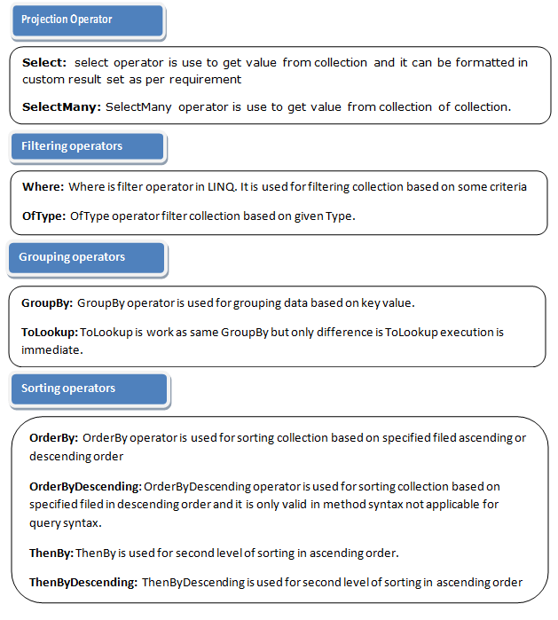
LINQ operators
Filtering Operators
Join Operators
Projection Operations
Sorting Operators
Grouping Operators
Conversions
Concatenation
Aggregation
Quantifier Operations
Partition Operations
Generation Operations
Set Operations
Equality
Element Operators

Slide 17
Query Syntax
Query syntax is similar to SQL (Structured Query Language) for the database.
It is defined within the C #.
Query syntax starts with from clause and can be end with Select or GroupBy clause.
Implicitly typed variable - var can be used to hold the result of the LINQ query.
We use various operators like filtering, joining, grouping, sorting operators to construct the desired result.

Slide 18
Example: LINQ Query syntax in C#
//string collection
IList<string> stringList = new List<string> {
"C# Tutorials",
"VB.NET Tutorials",
"Learn C++",
"MVC Tutorials",
"Java Introduction"
};
//LINQ Query Syntax
var result = from s in stringList
where s.Contains("Tutorials")
select s;

Slide 19
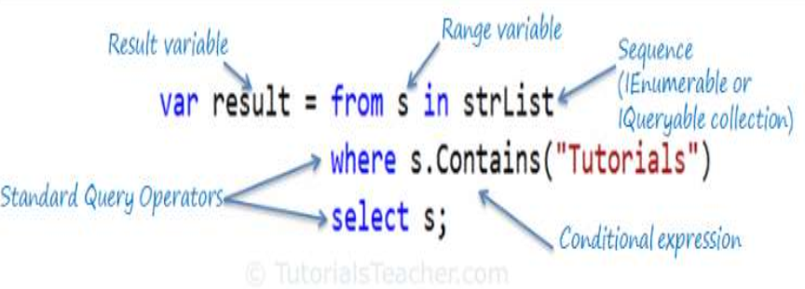
LINQ Query Syntax

Slide 20
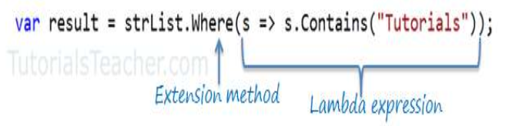
Method Syntax
Method Syntax is like calling extension method already included
Implicitly typed variable - var can be used to hold the result of the LINQ query.
//string collection
IList<string> stringList = new List<string> {
"C# Tutorials",
"VB.NET Tutorials",
"Learn C++",
"MVC Tutorials",
"Java Introduction"
};
var result = stringList.Where(s => s.Contains("Tutorials"));

Slide 21
Filtering Operators
Filtering is an operation to restrict the result set such that it has only selected elements satisfying a Where particular condition
Operator | Description | C# Query Expression Syntax
where | Filter values based on a predicate function | where
string[] words = {"humpty","dumpty","set","on","a","wall"};
IEnumerable<string> query = from word in words
where word.Length == 3
select word;
foreach (var str in query)
{
Console.WriteLine(str);
}

Slide 22
Grouping Operations
The operators put data into some groups based on a common GroupBy shared attribute
Operator | Description | C# Query Expression Syntax
GroupBy | Organize a sequence of items in groups and return them as an IEnumerable collection of type IGrouping<key, element> | group … by -or- group … by … into …
List<int> numbers = new List<int>(){35,44,200,84,3987,4,199,329,446,208 };
IEnumerable<IGrouping<int, int>> query = from number in numbers
group number by number % 2;
foreach (var group in query)
{
Console.WriteLine(group.Key==0?"\nEvent numbers:":"\nOdd numbers:");
foreach (var number in group)
{
Console.Write(number + ", ");
}
}

Slide 23
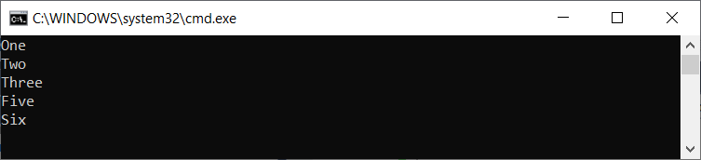
Concatenation Operations
Performs concatenation of two sequences and is quite similar to the Union operator in terms of its operation except of the fact that this does not remove duplicates.
IList<string> collection1 = new List<string>() { "One", "Two", "Three" };
IList<string> collection2 = new List<string>() { "Five", "Six" };
var collection3 = collection1.Concat(collection2);
foreach (string str in collection3)
{
Console.WriteLine(str);
}

Slide 24
Sorting Operators
A sorting operation allows ordering the elements of a sequence on basis of a single or OrderBy,OrderByDescending, more attributes.
Sorting Operator | Description
OrderBy | Sorts the elements in the collection based on specified fields in ascending or decending order.
OrderByDescending | Sorts the collection based on specified fields in descending order. Only valid in method syntax.
ThenBy | Only valid in method syntax. Used for second level sorting in ascending order.
ThenByDescending | Only valid in method syntax. Used for second level sorting in descending order.
Reverse | Only valid in method syntax. Sorts the collection in reverse order.

Slide 25
Sorting Operators
IList<Student> studentList = new List<Student>() {
new Student() { StudentId = 1, StudentName = "John", Age = 18 } ,
new Student() { StudentId = 2, StudentName = "Steve", Age = 15 },
new Student() { StudentId = 3, StudentName = "Bill", Age = 25 } ,
new Student() { StudentId = 4, StudentName = "Ram" , Age = 20 } ,
new Student() { StudentId = 5, StudentName = "Ron" , Age = 19 }
};
var orderByResult = from s in studentList
orderby s.StudentName
select s;
var orderByDescendingResult = from s in studentList
orderby s.StudentName descending
select s;

Slide 26
Equality Operations
Compares two sentences (enumerable ) and determine are SequenceEqual they an exact match or not.
Student john = new Student() { StudentId=1,StudentName="John",Age=19};
Student steve = new Student() { StudentId = 2, StudentName = "Steve", Age = 20 };
Student bill = new Student() { StudentId = 3, StudentName = "Bill", Age = 21 };
List<Student> students1 = new List<Student>() { john, steve };
List<Student> students2 = new List<Student>() { john, steve };
List<Student> students3 = new List<Student>() { john, steve,bill };
bool equal = students1.SequenceEqual(students2);
bool notEqual = students1.SequenceEqual(students3);

Slide 27
LINQ to Objects 1-3
LINQ to Objects offers a fresh approach to collections
Before we had to write long coding (foreach loops of much complexity) for retrieval of data from a collection
Now we write declarative code which clearly describes the desired data that is required to retrieve.
LINQ to Objects offers a fresh approach to collections Before we had to write long coding (foreach loops of much complexity) for retrieval of data from a collection Now we write declarative code which clearly describes the desired data that is required to retrieve.
LINQ to Objects offers a fresh approach to collections
Before we had to write long coding (foreach loops of much complexity) for retrieval of data from a collection
Now we write declarative code which clearly describes the desired data that is required to retrieve.

Slide 28
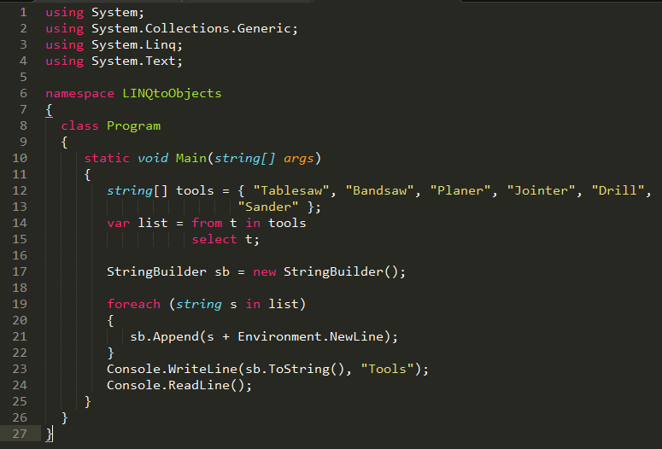
LINQ to Objects 2-3

Slide 29

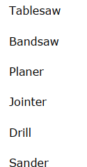
LINQ to Objects 3-3
In the example, an array of strings (tools) is used as the collection of objects
Queried using LINQ to Objects
The output will be ..

Slide 30
Data Source Transformation
(LINQ) is not only about retrieving data.
We can use a source sequence as input and modify it in many ways to create a new output sequence.
We Can ...
Merge multiple input sequences into a single output sequence that has a new type.
Create output sequences whose elements consist of only one or several properties of each element in the source sequence.
Create output sequences whose elements consist of the results of operations performed on the source data.
Create output sequences in a different format. For example, you can transform data from SQL rows or text files into XML.

Slide 31
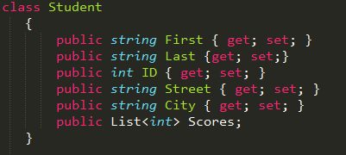
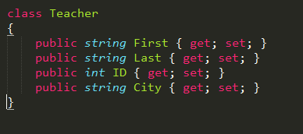
Joining Multiple Inputs into One Output Sequence 1-3

Slide 32
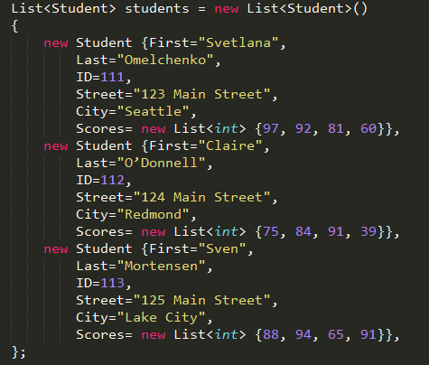
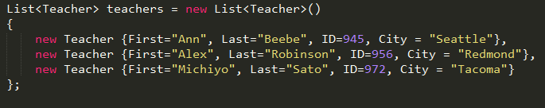
Joining Multiple Inputs into One Output Sequence 2-3

Slide 33
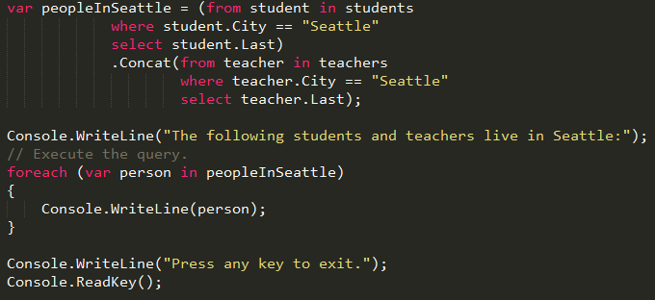
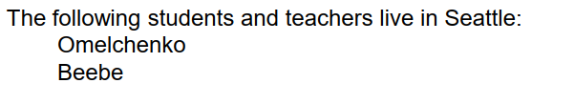
Joining Multiple Inputs into One Output Sequence 3-3
Output will be…

Slide 34


Create output sequences whose elements consist of only one or several properties of each element in the source sequence. 1-2
Select one member of the source element
Create elements that contain more than one property from the source element

Slide 35
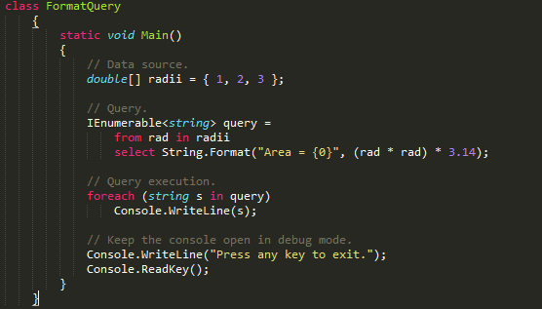
Create output sequences whose elements consist of only one or several properties of each element in the source sequence. 2-2

Slide 36
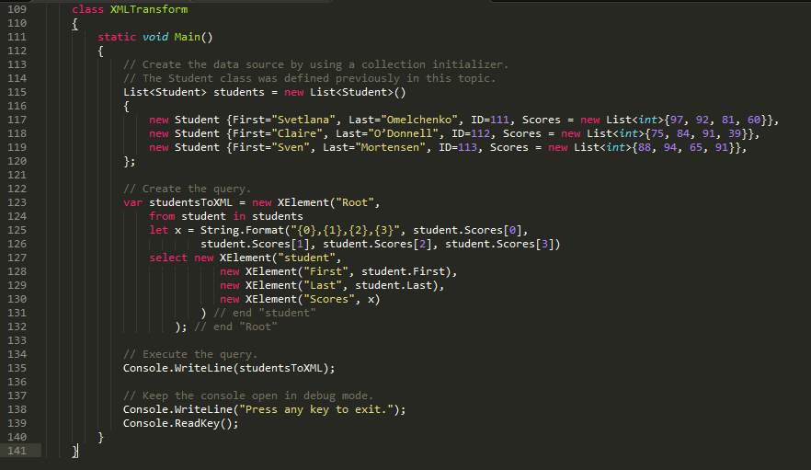
Create output sequences in a different format.

Slide 37
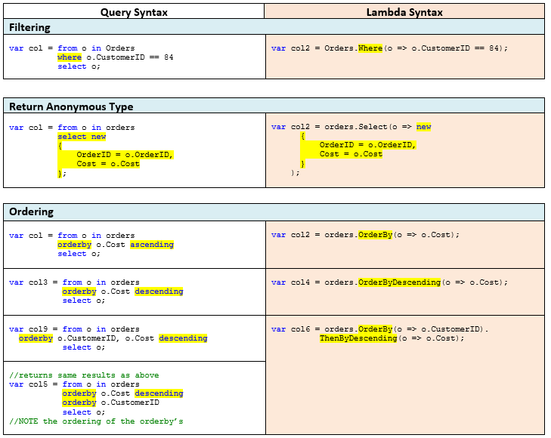
Query Syntax and Lambda Syntax (1)

Slide 38
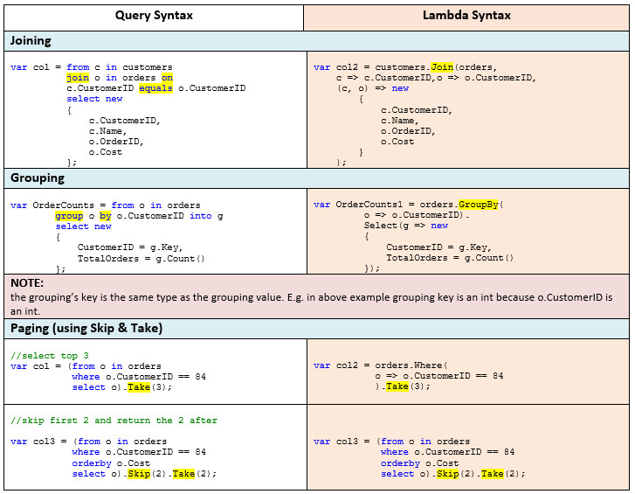
Query Syntax and Lambda Syntax (2)

Slide 39
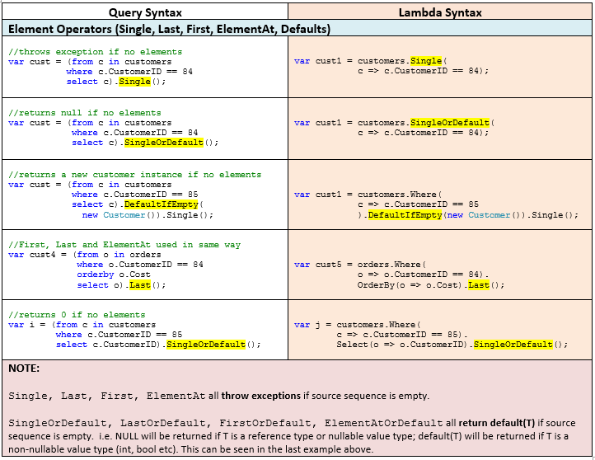
Query Syntax and Lambda Syntax (3)

Slide 40
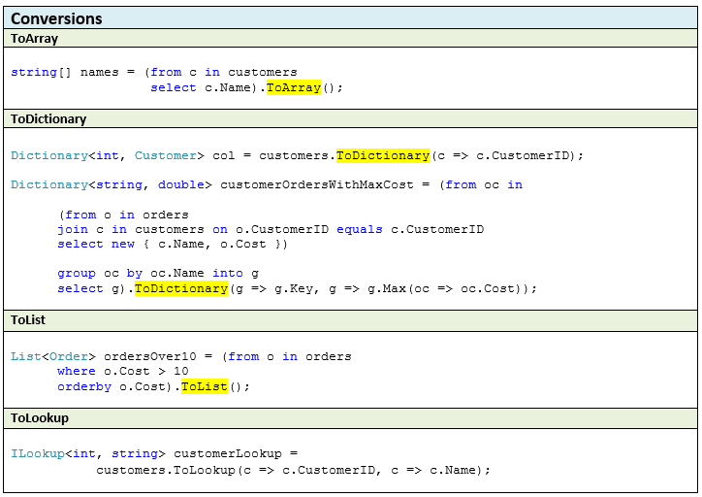
Query Syntax and Lambda Syntax (4)

Slide 41
References
http://www.tutorialspoint.com/linq/
https://msdn.microsoft.com/en-us/library/mt693042.aspx
https://en.wikipedia.org/wiki/Language_Integrated_Query

Slide 42

Thank you

